Slide 1
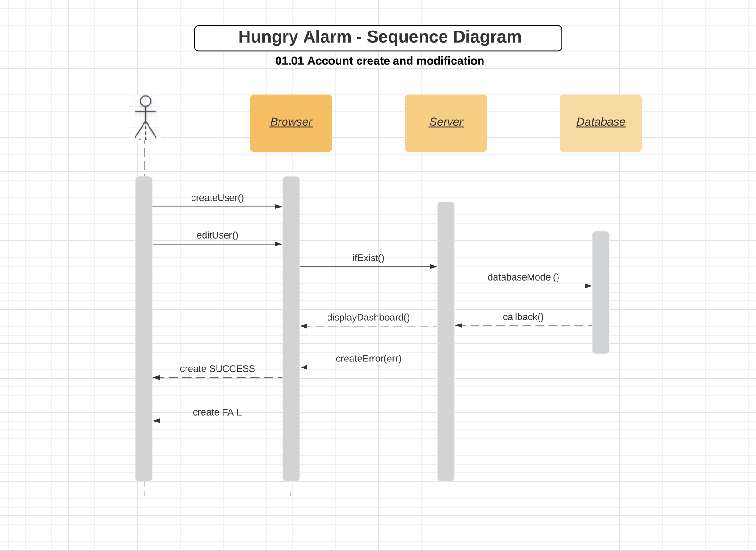
Notes:
01.01 Account create and modification
https://www.lucidchart.com/documents/edit/cf9629c3-f254-4779-bc14-2197a3ab00ff/0_0?shared=true
01.01 Account create and modification https://www.lucidchart.com/documents/edit/cf9629c3-f254-4779-bc14-2197a3ab00ff/0_0?shared=true
01.02 Account Authentication https://www.lucidchart.com/documents/edit/1b9930b9-69b1-420a-a134-e05e38047d01/0_0?shared=true
01.03 Account Summary https://www.lucidchart.com/documents/edit/cf9629c3-f254-4779-bc14-2197a3ab00ff/mrzMT1NVmoEQ?shared=true
02.01 Deal/Event Searching https://www.lucidchart.com/documents/edit/1b9930b9-69b1-420a-a134-e05e38047d01/7LzMutS7xPG7?shared=true

Slide 2
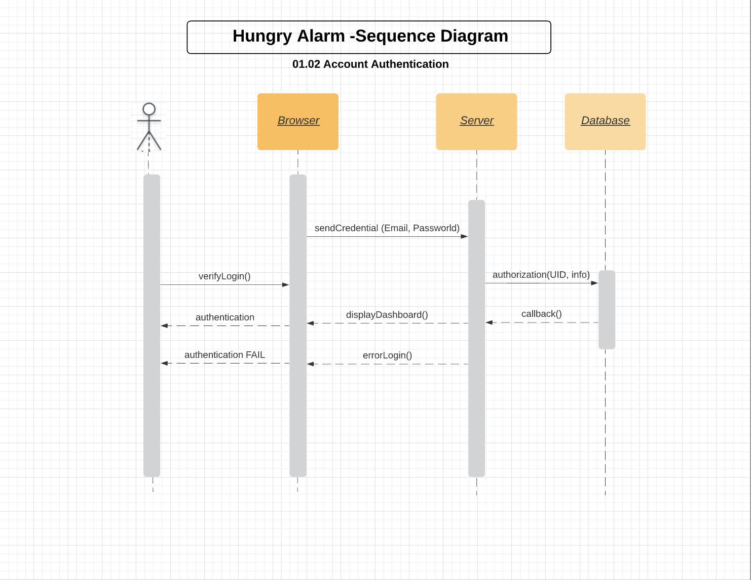
Notes:
01.02 Account Authentication
https://www.lucidchart.com/documents/edit/cf9629c3-f254-4779-bc14-2197a3ab00ff/6DzMiaZ9iNX7?shared=true

Slide 3
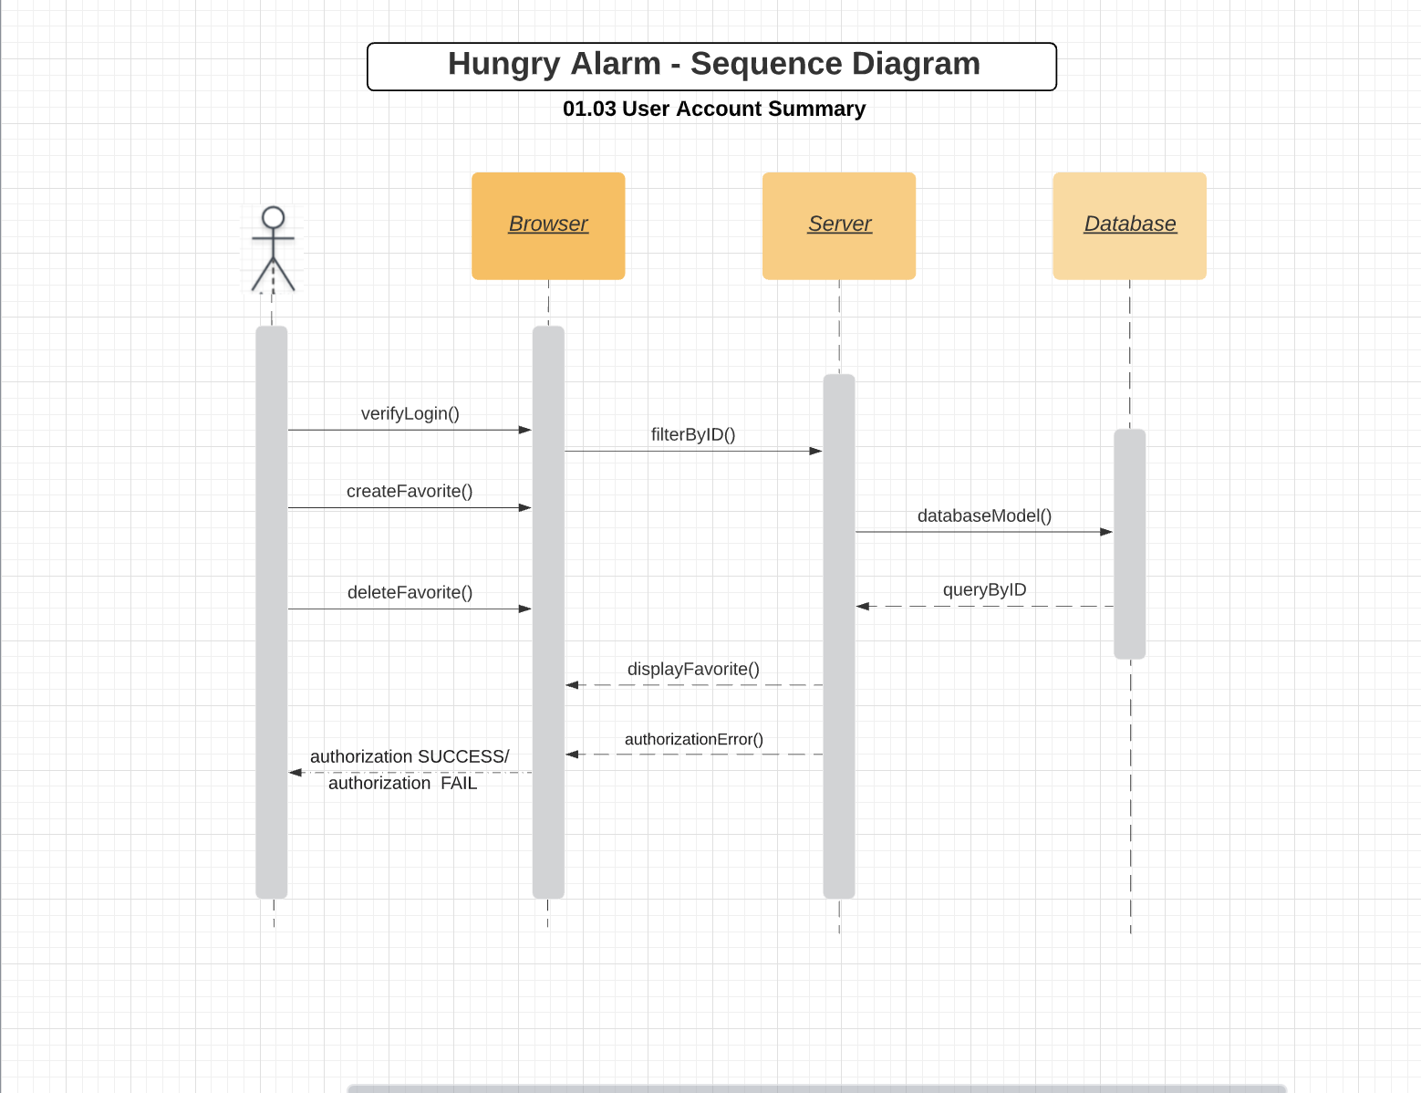
Notes:
01.03 Account Summary
https://www.lucidchart.com/documents/edit/cf9629c3-f254-4779-bc14-2197a3ab00ff/mrzMT1NVmoEQ?shared=true

